Slide 1
MECH307 Project 1, S21
Kağan Uçak, 0069435
19.03.2021

Slide 2
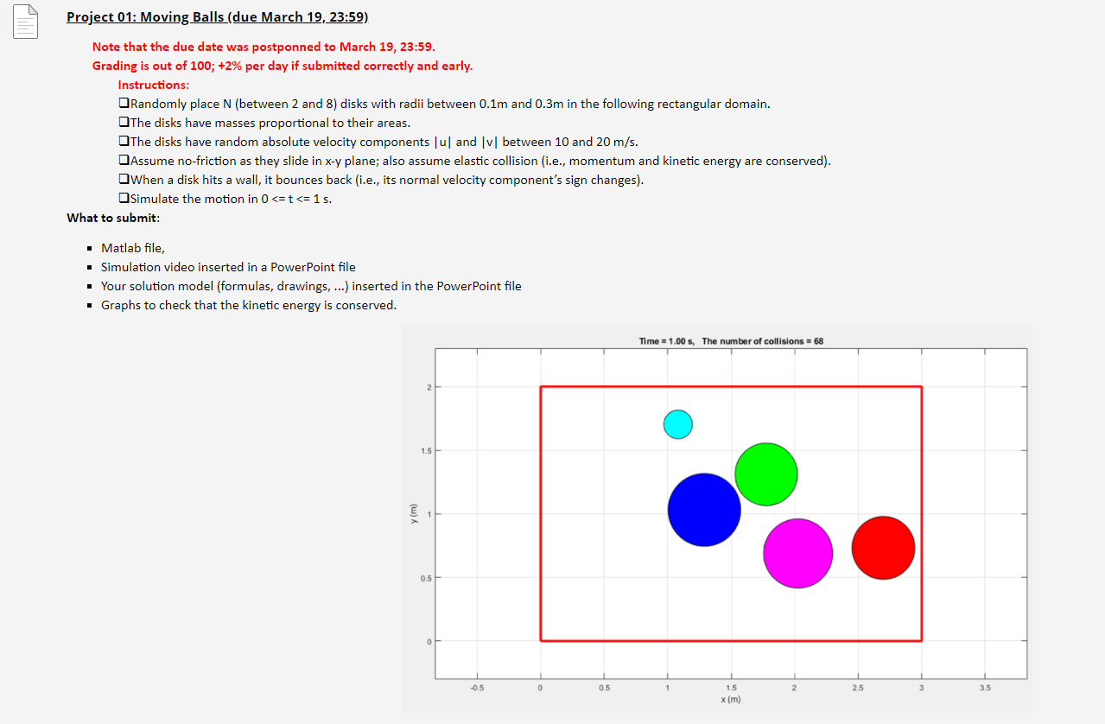

Slide 3
Coefficient of Restitution (0<=e<=1)
Coefficient of restitution indicates the ratio of the final to initial relative velocity between two objects that collide[1]. If it equals to 1, then the collision is perfectly elastic. It also indicates the ratio of kinetic energy conserved[1].
In real case, the value is always less than 1, due to the lost energy, which are heat, rotational kinetic energy, and plastic deformation[1].
For instance, coefficient of restitution of glass (borosilicate) is approximately 0.66[1].
For this project, e=1 has been desired. Additionaly, different values can be assigned to the coefficient in my project. Howeveri due to the repetition problems, it works effectively in the range 0.8<e<1.
[1] https://en.wikipedia.org/wiki/Coefficient_of_restitution

Slide 4
Mathematical Calculations For Collisions
First, I have calculated the angles and rotation Normal velocities, which are the direction from the center of the first object to the second object, and Tangential velocities, which are the perpendicular to the Normal direction. Then I checked them from that document.
I have used Oblique Impact to calculate the velocity values after collisions.
The most significant point for Oblique Impact is tangential momentum values of each objects do not change after collisions.

Slide 5
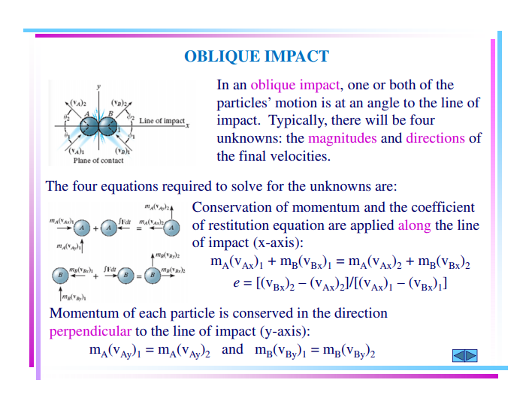
The most
significant point

Slide 6
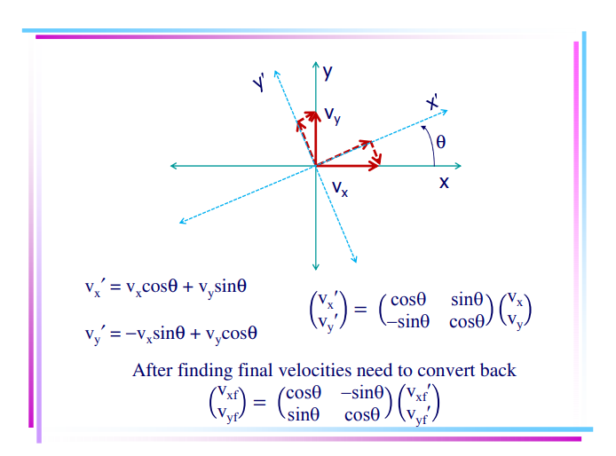

Slide 7
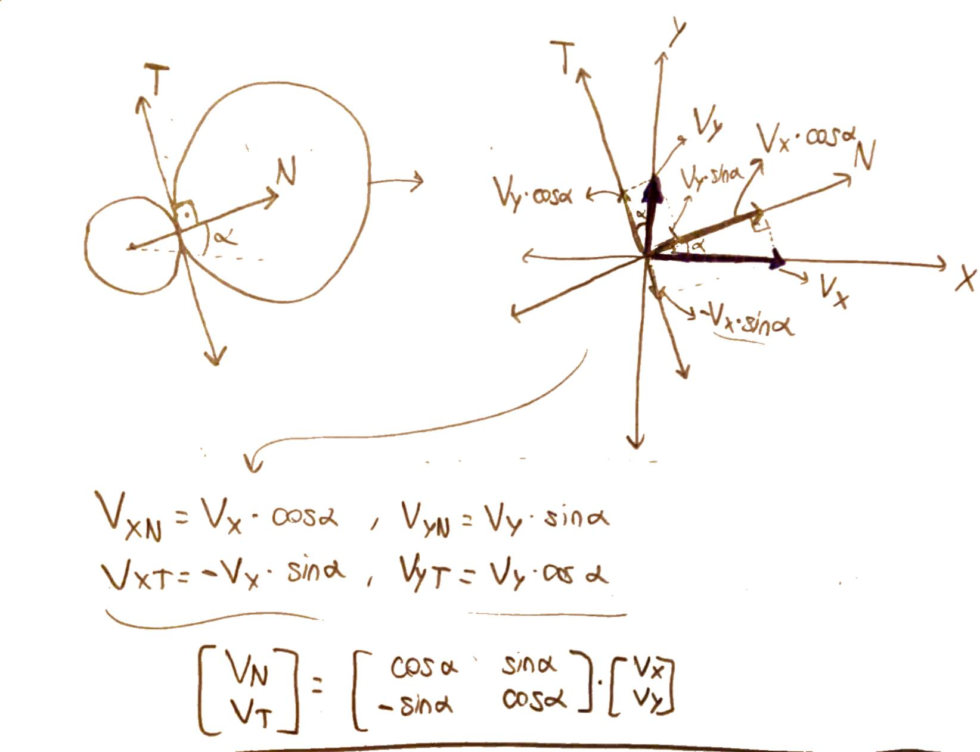

Slide 8
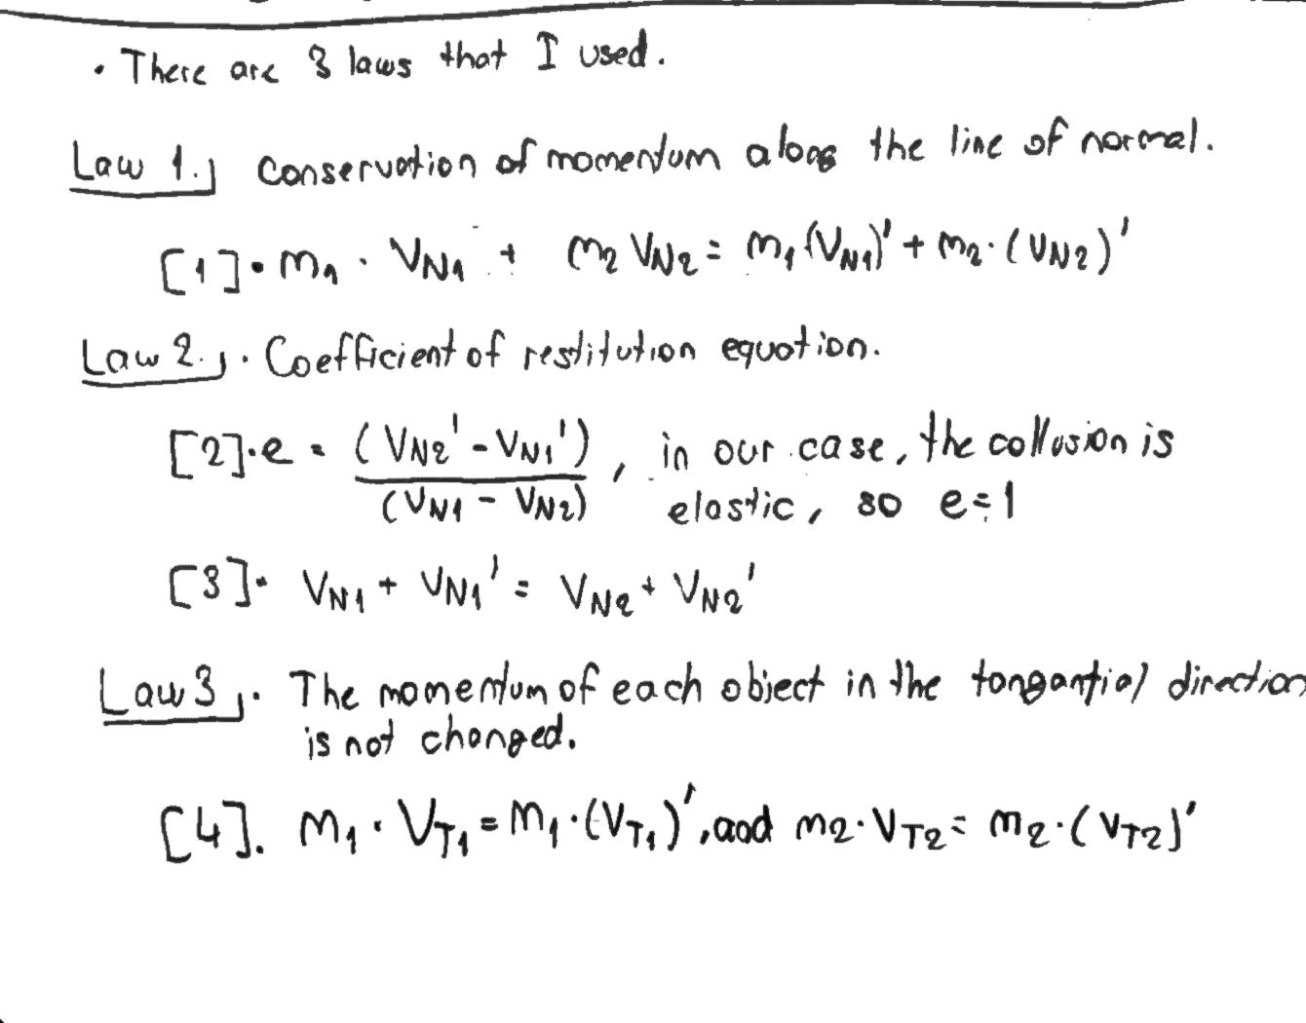

Slide 9
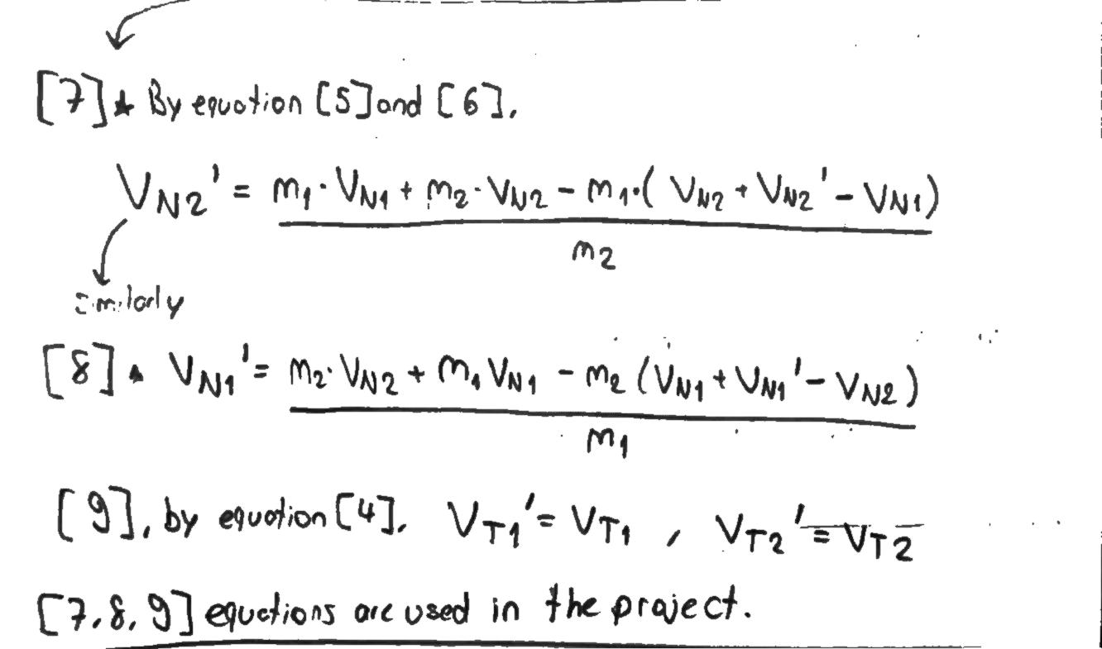

Slide 10
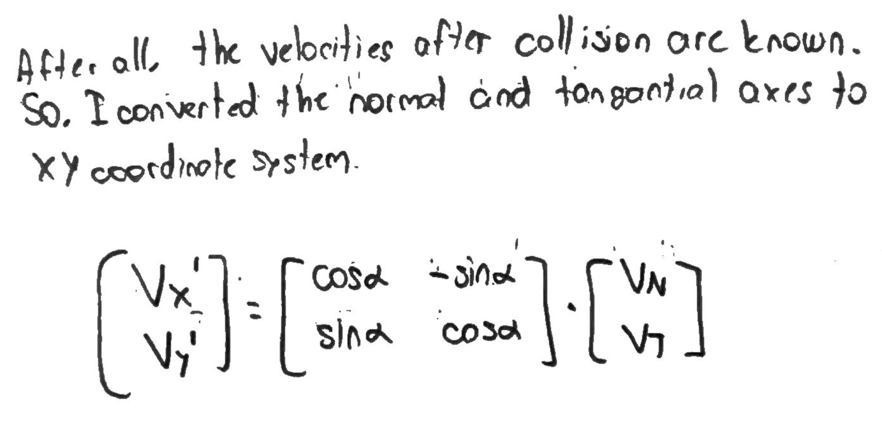

Slide 11
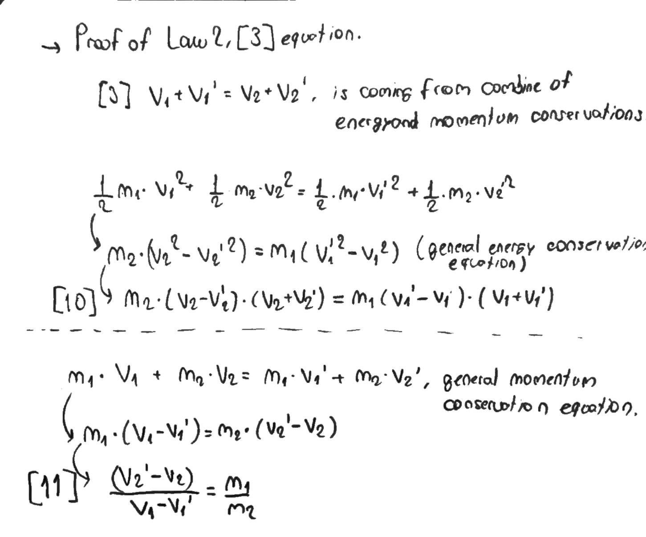

Slide 12
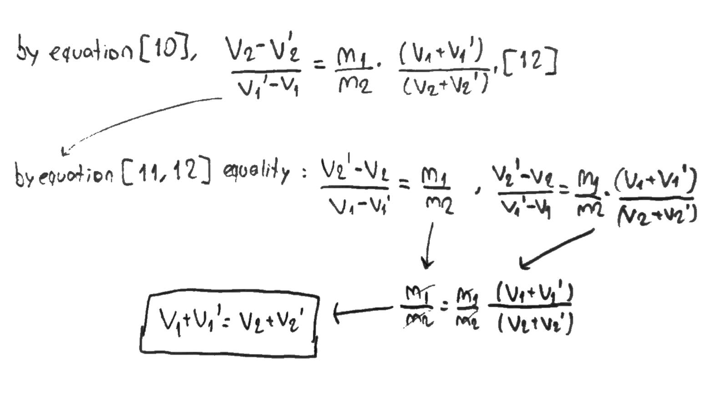

Slide 13

Coefficient of restitution= 1
If the collisions are perfectly elastic, the coefficent equals 1.

Slide 14
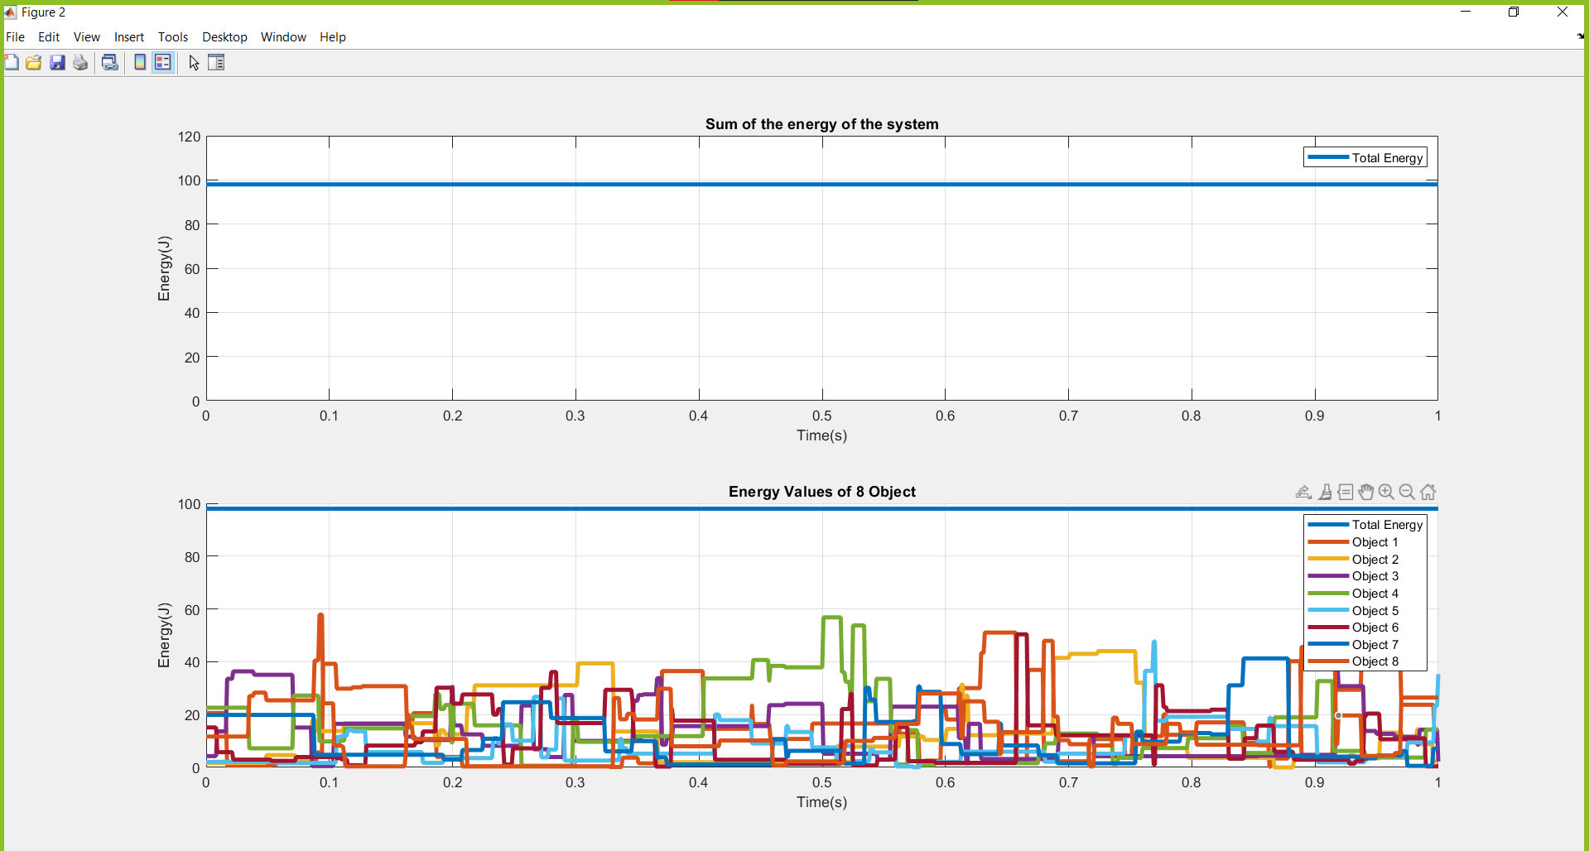

Slide 15
Coefficient of restitution= 0.7
The code could not work correctly for lower values due to the repetition problem.

Slide 16
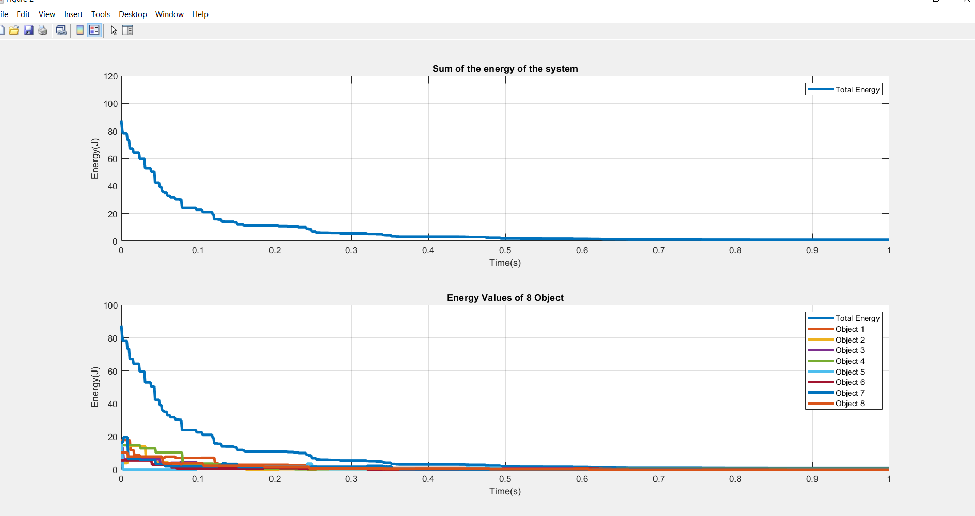

Slide 17
Differences and Problems
[D 1] The colors of balls can be similar, because they need to be randomly assign to plot all the balls via only one ‘patch’ command.
[D 2] The code ask to users number of balls and coefficient of resistitution. But they can be assign default by making the line 19 a command line via ‘%’.
[D 3]The position of the first 2 balls are initially assigned.
[P 1] The balls can overlap and repeat a same movements if COR is less than 1.

Slide 18
%MECH307 Project 1(Inside a Rectangular) by Kagan Ucak, 0069435
%27.02.2021
clc, clear, close all
%% Needed parameters.
th = 0:pi/50:2*pi; %angle for drawing circiles
txt=["k","b","m","r","y","g","w","c","k"]; %color
dt=0.001;
fps= linspace(0,1,1/dt +1); %the precise of simulation. dt is equal to 0.0001 s.
n=1; %number of collusion
c_r=input("Coefficient of Restitution(for elastic collisions e=1): ");
cons=0; %a paramater to save energy values to array "data"
data=[0 0; 1 1]; %for energy values
data_2=[0 0 0 0 0; 1 1 1 1 1]; %for save time and momentum paramaters before and after any collision, also to prevent the errors
sp=5; %to increase the speed of simulation
N= randi([2 8],1);
N=input("Number of ball: "); %If you wish you can define a number.
v_N=zeros(1,N); %normal velocity initial array
v_T=zeros(1,N); %for tangantial velocity initial array
%% To define the positions of center of balls.
s=[0.5 1;0.5 1]; %the initial position coordinates
r=randi([1000 3000],[1 N])/10000; %To define radius of balls.
M=r.^2; %To define the mass of balls.

Slide 19
for i=[3:N]
s_1=randi([300 2700],1);
s_2=randi([300 1700],1);
s(1,i)= s_1/1000;
s(2,i)= s_2/1000;
j=0;
while j~=i
j=j+1;
while ((s(1,i)-s(1,j))^2 +(s(2,i)-s(2,j))^2)<=(r(i)+r(j))^2 && i~=j
s_1=randi([300 2700],1);
s_2=randi([300 1700],1);
s(1,i)= s_1/1000;
s(2,i)= s_2/1000;
j=0;
break
end
end
end
%% To define X and Y directional velocities.
v= randi([round(1000*sqrt(2)) round(2000*sqrt(2))],[1 N])/100;
delta=rand(1,N)*2*pi;
v_x=zeros(1,N);
v_y=zeros(1,N);

Slide 20
for i=1:N
v_x(i)=v(i).*sin(delta(i));
v_y(i)=v(i).*cos(delta(i));
end
%% To analyze every dt second situation
b_s_1(1,:)=s(1,:);
b_s_2(1,:)= s(2,:);
bb_v_x= zeros(round(1/dt),N);
bb_v_y= zeros(round(1/dt),N);
dc= {};
for i=1:N
dc_1=zeros(round(1/dt),N);
dc(i)={dc_1};
end
for p =fps
% disp(p)
for i= 1:N %step by step every ball
s(1,i)= s(1,i)+(dt*v_x(i));
s(2,i)= s(2,i)+(dt*v_y(i));
b_s_1(round(p/dt+1),i)=s(1,i);
b_s_2(round(p/dt+1),i)= s(2,i);
bb_v_x(round(p/dt+1),i)=v_x(i);
bb_v_y(round(p/dt+1),i)= v_y(i);
%% If ball will hit wall after one dt time, balls change one direction of their velocities.
if (s(1,i)+(dt*v_x(i))+r(i) >=3 ||s(1,i)+(dt*v_x(i))-r(i) <=0) %to avoid repetition one dt time before
v_x(i)=-c_r*v_x(i);
end
if (s(2,i)+(dt*v_y(i))+r(i) >=2 || s(2,i)+(dt*v_y(i))-r(i)<=0)
v_y(i)=-c_r*v_y(i);
end
end
%% To calculate velocities of balls after collisions
b_v_x= v_x;
b_v_y= v_y;
for i= 1:N-1 %to take a ball
dc_1=cell2mat(dc(i));
for i_2= i+1:N %to compare it with another ball
dc_1(round(p/dt+1),i_2)=sqrt((s(1,i)-s(1,i_2))^2 +(s(2,i)-s(2,i_2))^2);
if ((s(1,i)-s(1,i_2))^2 +(s(2,i)-s(2,i_2))^2)<=(r(i)+r(i_2))^2 %if the distance between their radius is small then dum of their radius, they collect
n=n+1;
b_v_x(i)= v_x(i); %to bake up the first velocities if the case of repetition
b_v_y(i)= v_y(i);
b_v_x(i_2)=v_x(i_2);
b_v_y(i_2)=v_y(i_2);
%% To change axis
teta= atan((s(2,i)-s(2,i_2))/(s(1,i)-s(1,i_2))); %the angle between the normal axis and X axis.
v_N(i)=v_x(i)*cos(teta)+sin(teta)*v_y(i);
v_T(i)=v_y(i)*cos(teta)-v_x(i)*sin(teta);
v_N(i_2)=v_x(i_2)*cos(teta)+sin(teta)*v_y(i_2);
v_T(i_2)=v_y(i_2)*cos(teta)-v_x(i_2)*sin(teta);

Slide 21
%% to calculate new velocities after collections
b2_v_N= v_N; %because v_N(i) will change, purpuse f b2_V_N is to calculate v_N(i_2)
b2_v_T= v_T;
v_N(i)=M(i)/(M(i)+M(i_2))*(v_N(i)+M(i_2)/M(i)*v_N(i_2)-c_r*M(i_2)/M(i)*(v_N(i)-v_N(i_2)));
v_N(i_2)= M(i_2)/(M(i)+M(i_2))*(v_N(i_2)+M(i)/M(i_2)*b2_v_N(i)-c_r*M(i)/M(i_2)*(v_N(i_2)-b2_v_N(i)));
%% rotate N and T axis to x and y axis
v_x(i)= cos(teta)*v_N(i)-v_T(i)*sin(teta);
v_y(i)= sin(teta)*v_N(i)+v_T(i)*cos(teta);
v_x(i_2)= (cos(teta)*v_N(i_2)-v_T(i_2)*sin(teta));
v_y(i_2)= (sin(teta)*v_N(i_2)+v_T(i_2)*cos(teta));
%% to prevent repetitions,
data_2(n,1)=b_v_x(i)*M(i)+b_v_x(i_2)*M(i_2); %x momentum values before the collision
data_2(n,2)=v_x(i)*M(i)+v_x(i_2)*M(i_2); %x momentum values after the collision
data_2(n,3)=b_v_y(i)*M(i)+b_v_y(i_2)*M(i_2); %y momentum values before the collision
data_2(n,4)=v_y(i)*M(i)+v_y(i_2)*M(i_2); %y momentum values after the collision
data_2(n,5)=p; %the time of collision
if round((data_2(n-1,1:4)*10000))== round(10000*data_2(n,1:4)) %if momentum values of consecutive collisions is exactly same, it is probably a repetition
if round(10000*(data_2(n-1,5)+dt))<=round(10000*data_2(n,5)) %if the time differences between these collisions is less than or equal to dt. It is most probably a repetition.
if round(10000*(data_2(n-1,5)+dt*10))>round(10000*data_2(n,5)) % If the time difference between these collisions is very much, there may not be a repetition. So I eliminate that.
v_x(i)= b_v_x(i); %velocity values turn back before collision
v_y(i)= b_v_y(i) ;
v_x(i_2)=b_v_x(i_2);
v_y(i_2)=b_v_y(i_2);
n=n-1; % number of collision
end
end
end
end
dc(i)={dc_1};
end
end
%% to collect energy values at time p
cons=cons+1;
data(cons,1)=sum(M.*v_x.^2 + M.*v_y.^2)/2;
end

Slide 22
%% to plot simulation
figure(1)
hold on
grid on
set(gcf, 'WindowState', 'maximized'); %in order to maximize the window
pause(0.1)
rectangle('Position',[0 0 3 2],'EdgeColor','r', 'LineWidth',3)
n=-1;
j_2=data_2(:,5).';
for p=fps
for j=j_2
if round(p/dt)==round(j/dt)
n=n+1;
end
end
for i=1:N
if mod(p,dt*sp)==0 %to cpu and time saving
xunit = r(i) * cos(th) + b_s_1(round(p/dt+1),i);
yunit = r(i)* sin(th) + b_s_2(round(p/dt+1),i);
plot(xunit, yunit);
fill(xunit, yunit,txt(i));
hold on , grid on
axis equal
axis([-1 4 -0.5 2.5])
title("Time: " + p + "(s)"+ ", The Number of Collisions: "+(n))
rectangle('Position',[0 0 3 2],'EdgeColor','r', 'LineWidth',3)
quiver(b_s_1(round(p/dt+1),i),b_s_2(round(p/dt+1),i), 0.01*bb_v_x(round(p/dt+1),i) ,0.01*bb_v_y(round(p/dt+1),i), 'linewidth',2);
end
end
hold off
if mod(p,dt*sp)==0
pause(0.0000000001)
end
end

Slide 23
%% To plot total energy in the system
figure(2)
subplot(2,1,1);
ener=0.5*(M.*(bb_v_x.^2+bb_v_y.^2));
plot(fps, data(:,1),"linewidth",3)
hold on
txt_legend="Total Energy";
legend(txt_legend)
title("Sum of the energy of the system")
xlabel("Time(s)")
ylabel("Energy(J)")
axis([0 1 0 120])
grid on
%% To plot energy values of each objects
subplot(2,1,2);
hold on, grid on
plot(fps, data(:,1),"linewidth",3)
for i=[1:N]
plot(fps,ener(:,i),"linewidth",3)
txt_legend(i+1)={"Object " + i};
end
title("Energy Values of "+N+ " Object")
legend(txt_legend)
xlabel("Time(s)")
ylabel("Energy(J)")
axis auto

